Slide 1



UNIVERSITY INSTITUTE OF ENGINEERING
COMPUTER SCIENCE ENGINEERING
Bachelor of Engineering
Cloud Computing(CST-411)
Prepared By: Ms. Himanshu(E11818)
Topic: Service Models, Features of SaaS, PaaS and IaaS
DISCOVER . LEARN . EMPOWER

Slide 2
Learning Objectives & Outcomes
Objective:
To understand the different services provided by Cloud Computing
Outcome:
Student will understand
Service Models of Cloud Computing

Slide 3
Overview
Service Models
IaaS
Benefits and Issues of IaaS
PaaS
Benefits and Issues of PaaS
SaaS
Benefits and Issues of SaaS

Slide 4

Service Models

Slide 5

Service Models
Service Models are the reference models on which the Cloud Computing is based. These can be categorized into three basic service models as listed below:
1. Infrastructure as a Service (IaaS)
2. Platform as a Service (PaaS)
3. Software as a Service (SaaS)

Slide 6
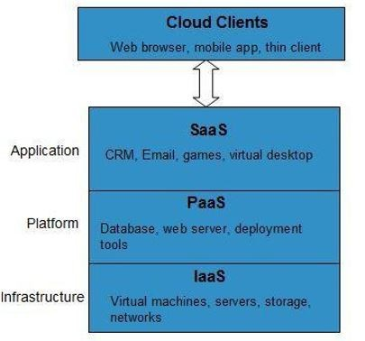
The Infrastructure as a Service (IaaS) is the most basic level of service.
Each of the service models make use of the underlying service model, i.e., each inherits the security and management mechanism from the underlying model, as shown in the following diagram:

Slide 7
Infrastructure as a Service (IaaS)
IaaS is the delivery of technology infrastructure as an on demand scalable service.
IaaS provides access to fundamental resources such as physical machines, virtual machines, virtual storage, etc.
Apart from these resources, the IaaS also offers: •Virtual machine disk storage
Virtual local area network (VLANs)
Load balancers
IP addresses
Software bundles

Slide 8

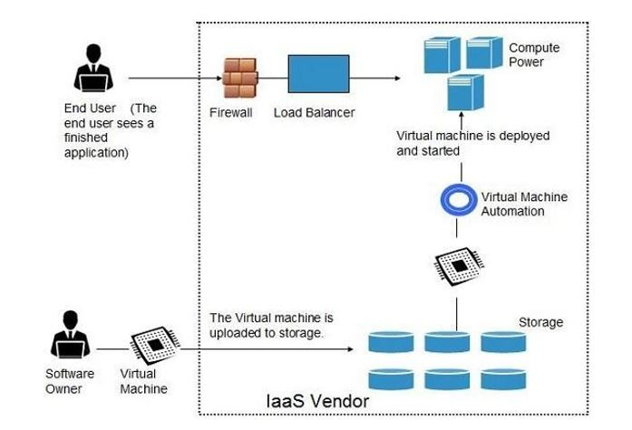
All of the above resources are made available to end user via server virtualization.
Resources are accessed by the customers as if they own them.

Slide 9
Benefits :
Full Control of the computing resources through hypervisor
Administrative Access to VMs.
Flexible and Efficient renting of Computer Hardware.
Portability, Interoperability with Legacy Applications.
Issues :
Compatibility with legacy security vulnerabilities
Virtual machine sprawl
Data erase practices
Robustness of VM-level isolation

Slide 10
Platform as a Service (PaaS)
PaaS provides the runtime environment for applications, development & deployment tools, etc.
PaaS provides all of the facilities required to support the complete life cycle of building and delivering web applications and services entirely from the Internet.
Google's App Engine, Force.com are examples of PaaS offering vendors.
Developer may log on to these websites and use the built-in API to create web-based applications.

Slide 11
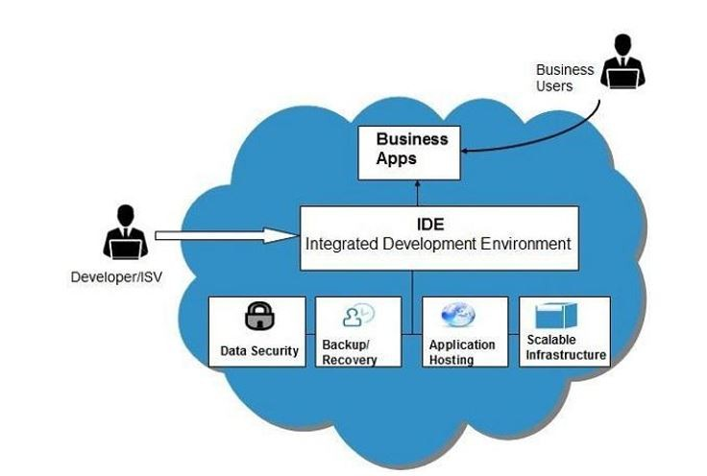
For example, an application written in Python against Google's API using Google's App Engine is likely to work only in that environment.
Note : vendor lock-in is the biggest problem in PaaS.

Slide 12
Benefits :
Lower administrative overhead
Lower total cost of ownership
Scalable solutions
More current system software
Issues :
Lack of portability between PaaS clouds
Event based processor scheduling
Security engineering of PaaS applications

Slide 13
Software as a Service (SaaS)
SaaS model allows to use software applications as a service to end users.
Software that is deployed on a hosted service and is accessible via Internet.
There are several SaaS applications, some of them are listed below:
Billing and Invoicing System
Customer Relationship Management (CRM) applications
Help Desk Applications
Human Resource (HR) Solutions

Slide 14
Benefits :
Modest software tools
Efficient use of software licenses
Centralized management & data
Platform responsibilities managed by providers
multitenant solutions
Issues :
Browser based risks
Network dependence
Lack of portability between SaaS clouds

Slide 15
References
Text books:
Buyya, Rajkumar, James Broberg, and Andrzej M. Goscinski, eds. Cloud computing: Principles and paradigms. Vol. 87. John Wiley & Sons, 2010.
Miller, Michael. Cloud computing: Web-based applications that change the way you work and collaborate online. Que publishing, 2008
Websites:
https://www.tutorialspoint.com//cloud_computing/index.htm

Slide 16
THANK YOU

